Slide 1
9-1

Slide 2
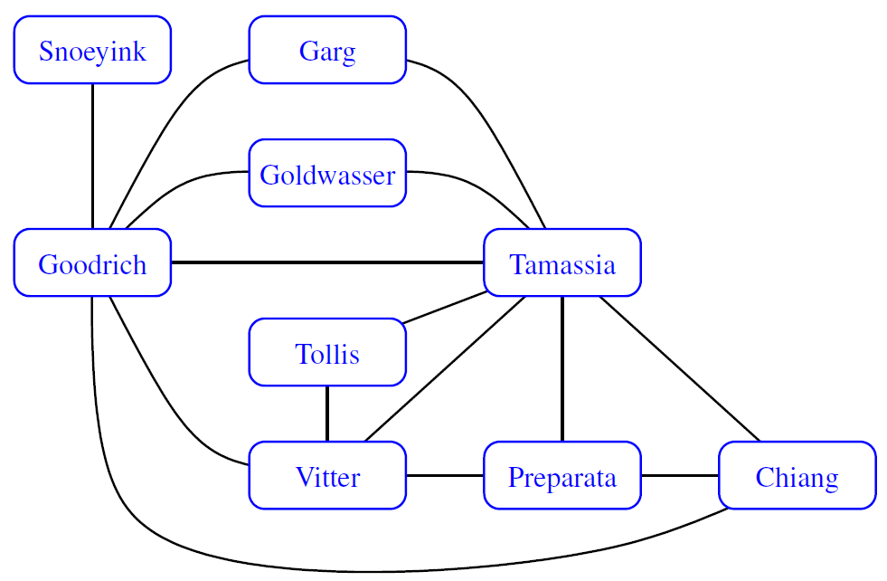
c
b
a
d
o
l
k
j
e
n
g
m
i
f
h

Slide 3
Adjacency Matrix representation
0
1
2
3
4
5
6
7
8
Chiang
0
 |  |  | h | f |  | e
 |  |  | b |  |  | c
 |  |  | o |  |  | d
h | b | o |  |  | a | l |  | n
f |  |  |  |  |  | g |  | i
 |  |  | a
e | c | d | l | g |  |  | k | j
 |  |  |  |  |  | k |  | m
 |  |  | n | i |  | j | m
Garg
1
Goldwasser
2
Goodrich
3
Preparata
4
Snoeyink
5
Tamassia
6
Tollis
7
Vitter
8

Slide 4
adjacency list representation
V
Chiang
e f h
Garg
b c
Goldwasser
d o
Goodrich
a b h l n o
Preparata
f g i
Snoeyink
a
Tamassia
c d e g j k l
Tollis
k m
Vitter
i j m n

Slide 5
9-3

Slide 6
2
5
1
4
6
8
3
7

Slide 7
Dijikstra’s Algorithm
9-6

Slide 8
∞
0
1
10
0
∞
4
5
∞
6
3
25
9
7
10
2
1
∞
4
5
4
∞
∞

Slide 9
∞
0
1
10
0
∞
4
5
5
6
3
25
9
7
10
2
1
9
4
5
4
∞
∞

Slide 10
∞
0
1
10
0
∞
4
5
5
6
3
25
9
7
10
2
1
9
4
5
4
∞
15

Slide 11
34
0
1
10
0
∞
4
5
5
6
3
25
9
7
10
2
1
9
4
5
4
10
13

Slide 12
34
0
1
10
0
17
4
5
5
6
3
25
9
7
10
2
1
9
4
5
4
10
13

Slide 13
34
0
1
10
0
17
4
5
5
6
3
25
9
7
10
2
1
9
4
5
4
10
13

Slide 14
21
0
1
10
0
17
4
5
5
6
3
25
9
7
10
2
1
9
4
5
4
10
13

Slide 15
21
0
1
10
0
17
4
5
5
6
3
25
9
7
10
2
1
9
4
5
4
10
13

Slide 16
Prim-Jarnik’s Algorithm
9-6

Slide 17
∞
0
1
10
0
∞
4
5
∞
6
3
25
9
7
10
2
1
∞
4
5
4
∞
∞

Slide 18
10
0
1
10
0
∞
4
5
5
6
3
25
9
7
10
2
1
9
4
5
4
∞
∞

Slide 19
10
0
1
10
0
∞
4
5
5
6
3
25
9
7
10
2
1
9
4
5
4
∞
10

Slide 20
10
0
1
10
0
∞
4
5
5
6
3
25
9
7
10
2
1
9
4
5
4
1
4

Slide 21
10
0
1
10
0
7
4
5
5
6
3
25
9
7
10
2
1
9
4
5
4
1
4

Slide 22
10
0
1
10
0
7
4
5
5
6
3
25
9
7
10
2
1
9
4
5
4
1
4

Slide 23
4
0
1
10
0
7
4
5
5
6
3
25
9
7
10
2
1
9
4
5
4
1
4

Slide 24
4
0
1
10
0
7
4
5
5
6
3
25
9
7
10
2
1
9
4
5
4
1
4

Slide 25
9-Bonus

Slide 26
Counter Example
4
v
0
4
5
9
Start
w
1
Goal
6
-8
5

Slide 27
10-1

Slide 28
Text:
a | a | a | b | a | a | d | a | a | b | a | a | a
1
2
3
Pattern:
a | a | b | a | a | a
4
5
6
7
8
9
a | a | b | a | a | a
10
11
a | a | b | a | a | a
12
a | a | b | a | a | a
13
14
15
a | a | b | a | a | a

Slide 29
Text:
a | a | a | b | a | a | d | a | a | b | a | a | a
16
17
Pattern:
a | a | b | a | a | a
18
a | a | b | a | a | a
19
20
21
22
23
24
a | a | b | a | a | a

Slide 30
10-2

Slide 31
Text:
a | a | a | b | a | a | d | a | a | b | a | a | a
3
2
1
Pattern:
a | a | b | a | a | a
4
a | a | b | a | a | a
10
9
8
7
6
5
Last-Occurrence Function
a | a | b | a | a | a
c | a | b | d
L(c) | 5 | 2 | -1

Slide 32
10-3

Slide 33
Text:
a | a | a | b | a | a | d | a | a | b | a | a | a
1
2
3
Pattern:
a | a | b | a | a | a
4
5
6
7
8
9
a | a | b | a | a | a
10
a | a | b | a | a | a
11
a | a | b | a | a | a
12
a | a | b | a | a | a

Slide 34
Text:
a | a | a | b | a | a | d | a | a | b | a | a | a
13
14
15
16
17
18
Pattern:
a | a | b | a | a | a
KMP Failure Function
j | 0 | 1 | 2 | 3 | 4 | 5
P[j] | a | a | b | a | a | a
F(j) | 0 | 1 | 0 | 1 | 2 | 2

Slide 35
KMP Failure Function
13
14
15
16
17
18
j | 0 | 1 | 2 | 3 | 4 | 5
P[j] | a | a | b | a | a | a
F(j) | 0 | 1 | 0 | 1 | 2 | 2
a | a | b | a | a | a

